Slide 7
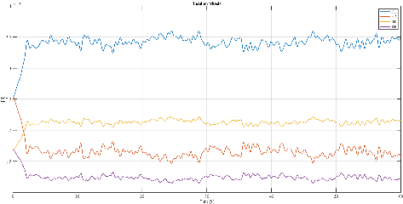
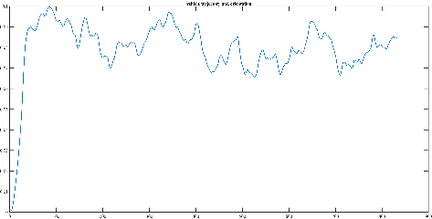
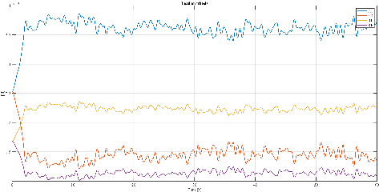
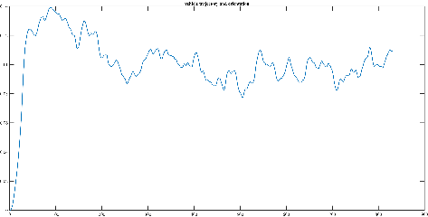
Main results analysis
Analysis of six different wind histories in different meteorological conditions (dry, wet and snow)
Comparison between wind history 1 and 4 in dry condition – same turbulence intensity, but different wind speed
The trends of the forces and aerodynamic moment in the two cases are similar, while the modulus changes considerably
[WH 1 on top, WH 4 on bottom]
As can be seen from the trajectory plot, in the second case the truck is more unbalanced
[WH 1 on top, WH 4 on bottom]

Slide 8
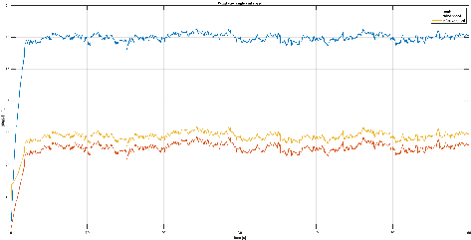
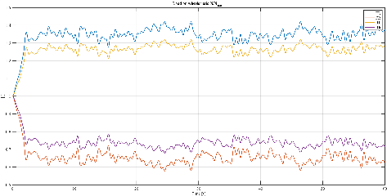
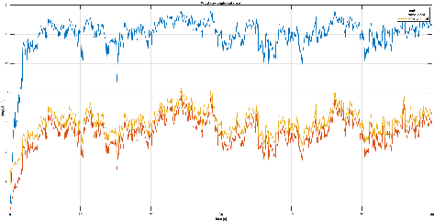
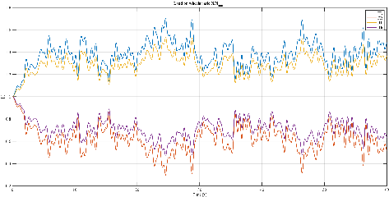
Main results analysis
Analysis of six different wind histories in different meteorological conditions (dry, wet and snow)
Comparison between wind history 1 and 3 in dry condition – same wind speed, but different turbulence intensity
The frequency content in the second case is more distributed at high frequencies, which is why the average value of the various quantities is similar in the two cases, while the peaks are clearly different. from the N/N plot, it is also useful to note that despite the peaks, we find ourselves with an average value of around 0.6, i.e. in a condition that is still safe

